Slide 1




Navigating the Path:
Developing a Whole Health Comprehensive Pain Care Measurement Framework
Thursday, March 6, 2025
2:00-3:30PM PT
Notes:
During this session we will talk about our work, as It related to developing a whole health comprehensive pain care measurement framework, We are excited to share what led us to this work, where we are in the process, and what we hope will come from these efforts ( hand off by 2:05)

Slide 2




Welcome
Benjamin Kligler MD MPH
Executive Director
Office of Patient Centered Care & Cultural Transformation
Veterans Health Administration
Taryn De Sio Garber, M.Ed., MS
Associate Director
Whole Health in The States & Special Projects
Academic Consortium for Integrative Medicine and Health
Barbara G. Bokhour, PhD
Director, Center for Health Optimization and Implementation Research, VA Bedford Healthcare System
Professor, Division of Preventive and Behavioral Medicine, Department of Population and Quantitative Health Sciences- University of Massachusetts Chan Medical School
Josh Plavin, MD, MPH, MBA
Medical Director & Division Chief, Comprehensive Pain Program, University of Vermont Medical Center
Clinical Lead, Osher Center for Integrative Health at the University of Vermont
Assistant Professor, University of Vermont Larner College of Medicine

Slide 3
Disclosures
The views expressed in this presentation are those of the authors and do not necessarily represent the views of the Department of Veterans Affairs.

Slide 4
Acknowledgement
El Rio Health: Doug Spegman, MD, MSPH, FACP, Chief Clinical Officer, Sue Dolence, LCSW, Director of Integrated Behavioral Health Programs, Alyson Striner, DPT
University of Vermont: Jon Porter, MD, Cara Feldman-Hunt, MA, NBC-HWC, Josh Plavin, MD, MPH, MBA, and Jerry Landau, PhD candidate
Veterans Health Administration: Benjamin Kligler MD MPH, Barbara G. Bokhour, PhD, The Evaluating Patient-Centered Care in VA Team (VA QUERI PEC13-001)
Thought Leader: Samantha Simmons, CEO of Academic Consortium for Integrative Medicine and Health, measurement framework thought leader and PI for Whole Health in The States
ACIMH: Jessica Tolbert, LCSW (WHITS Summer 24’ Intern) and ACIMH Marketing team support with graphics and web design
Alex H. Krist, MD and National Academies of Sciences, Engineering, and Medicine; Health and Medicine Division; Board on Health Care Services; Committee on Transforming Health Care to Create Whole Health: Strategies to Assess, Scale, and Spread the Whole Person Approach to Health for their 2023 Achieving Whole Health Consensus Study Report
National Center for Complementary and Integrative Health
In addition to the published work of many colleagues ☺
Notes:
The four of us have the privilege to discuss this work, and progress made but so many have supported and informed this work, and continue to do so.

Slide 5
Goal
The goal of this session is to:
Explore and discuss measuring whole health.
Discuss measurement examples from partners.
Share progress on our whole health comprehensive pain care measurement framework.
Learn from all of you!
Notes:
The goal of the session today is to offer an opportunity to explore and engage in discussion around the topic of measuring whole health using examples from comprehensive pain care programs and share progress being made on a measurement framework.

Slide 6
Learning Objectives
Participants will be able to identify how the measurement framework expands typical pain outcome metrics toward measuring Whole Health outcomes
Participants will be able to identify key insights from the discussion and process to developing the measurement framework that are applicable to their own organization.
Participants will be able to identify and consider different stakeholder groups when measuring whole health comprehensive pain care
Participants will be able to evaluate the usability and feasibility of the plan for our measurement framework and identify any gaps.
Notes:
By the end of this session we hope that all of you will be able to identify some way to expand typical pain outcome metrics to measuring whole health outcomes, identify some key insights from our work so far, consider the role of stakeholder groups, and provide some insight on the potential usability and any opportunity areas of the measurement framework we are developing.

Slide 7
Current State of Measuring Whole Health
Notes:
Dr. Kligler will provide and overview of where Whole Health measurement is today. (Ben wrap up at 2:13)

Slide 8
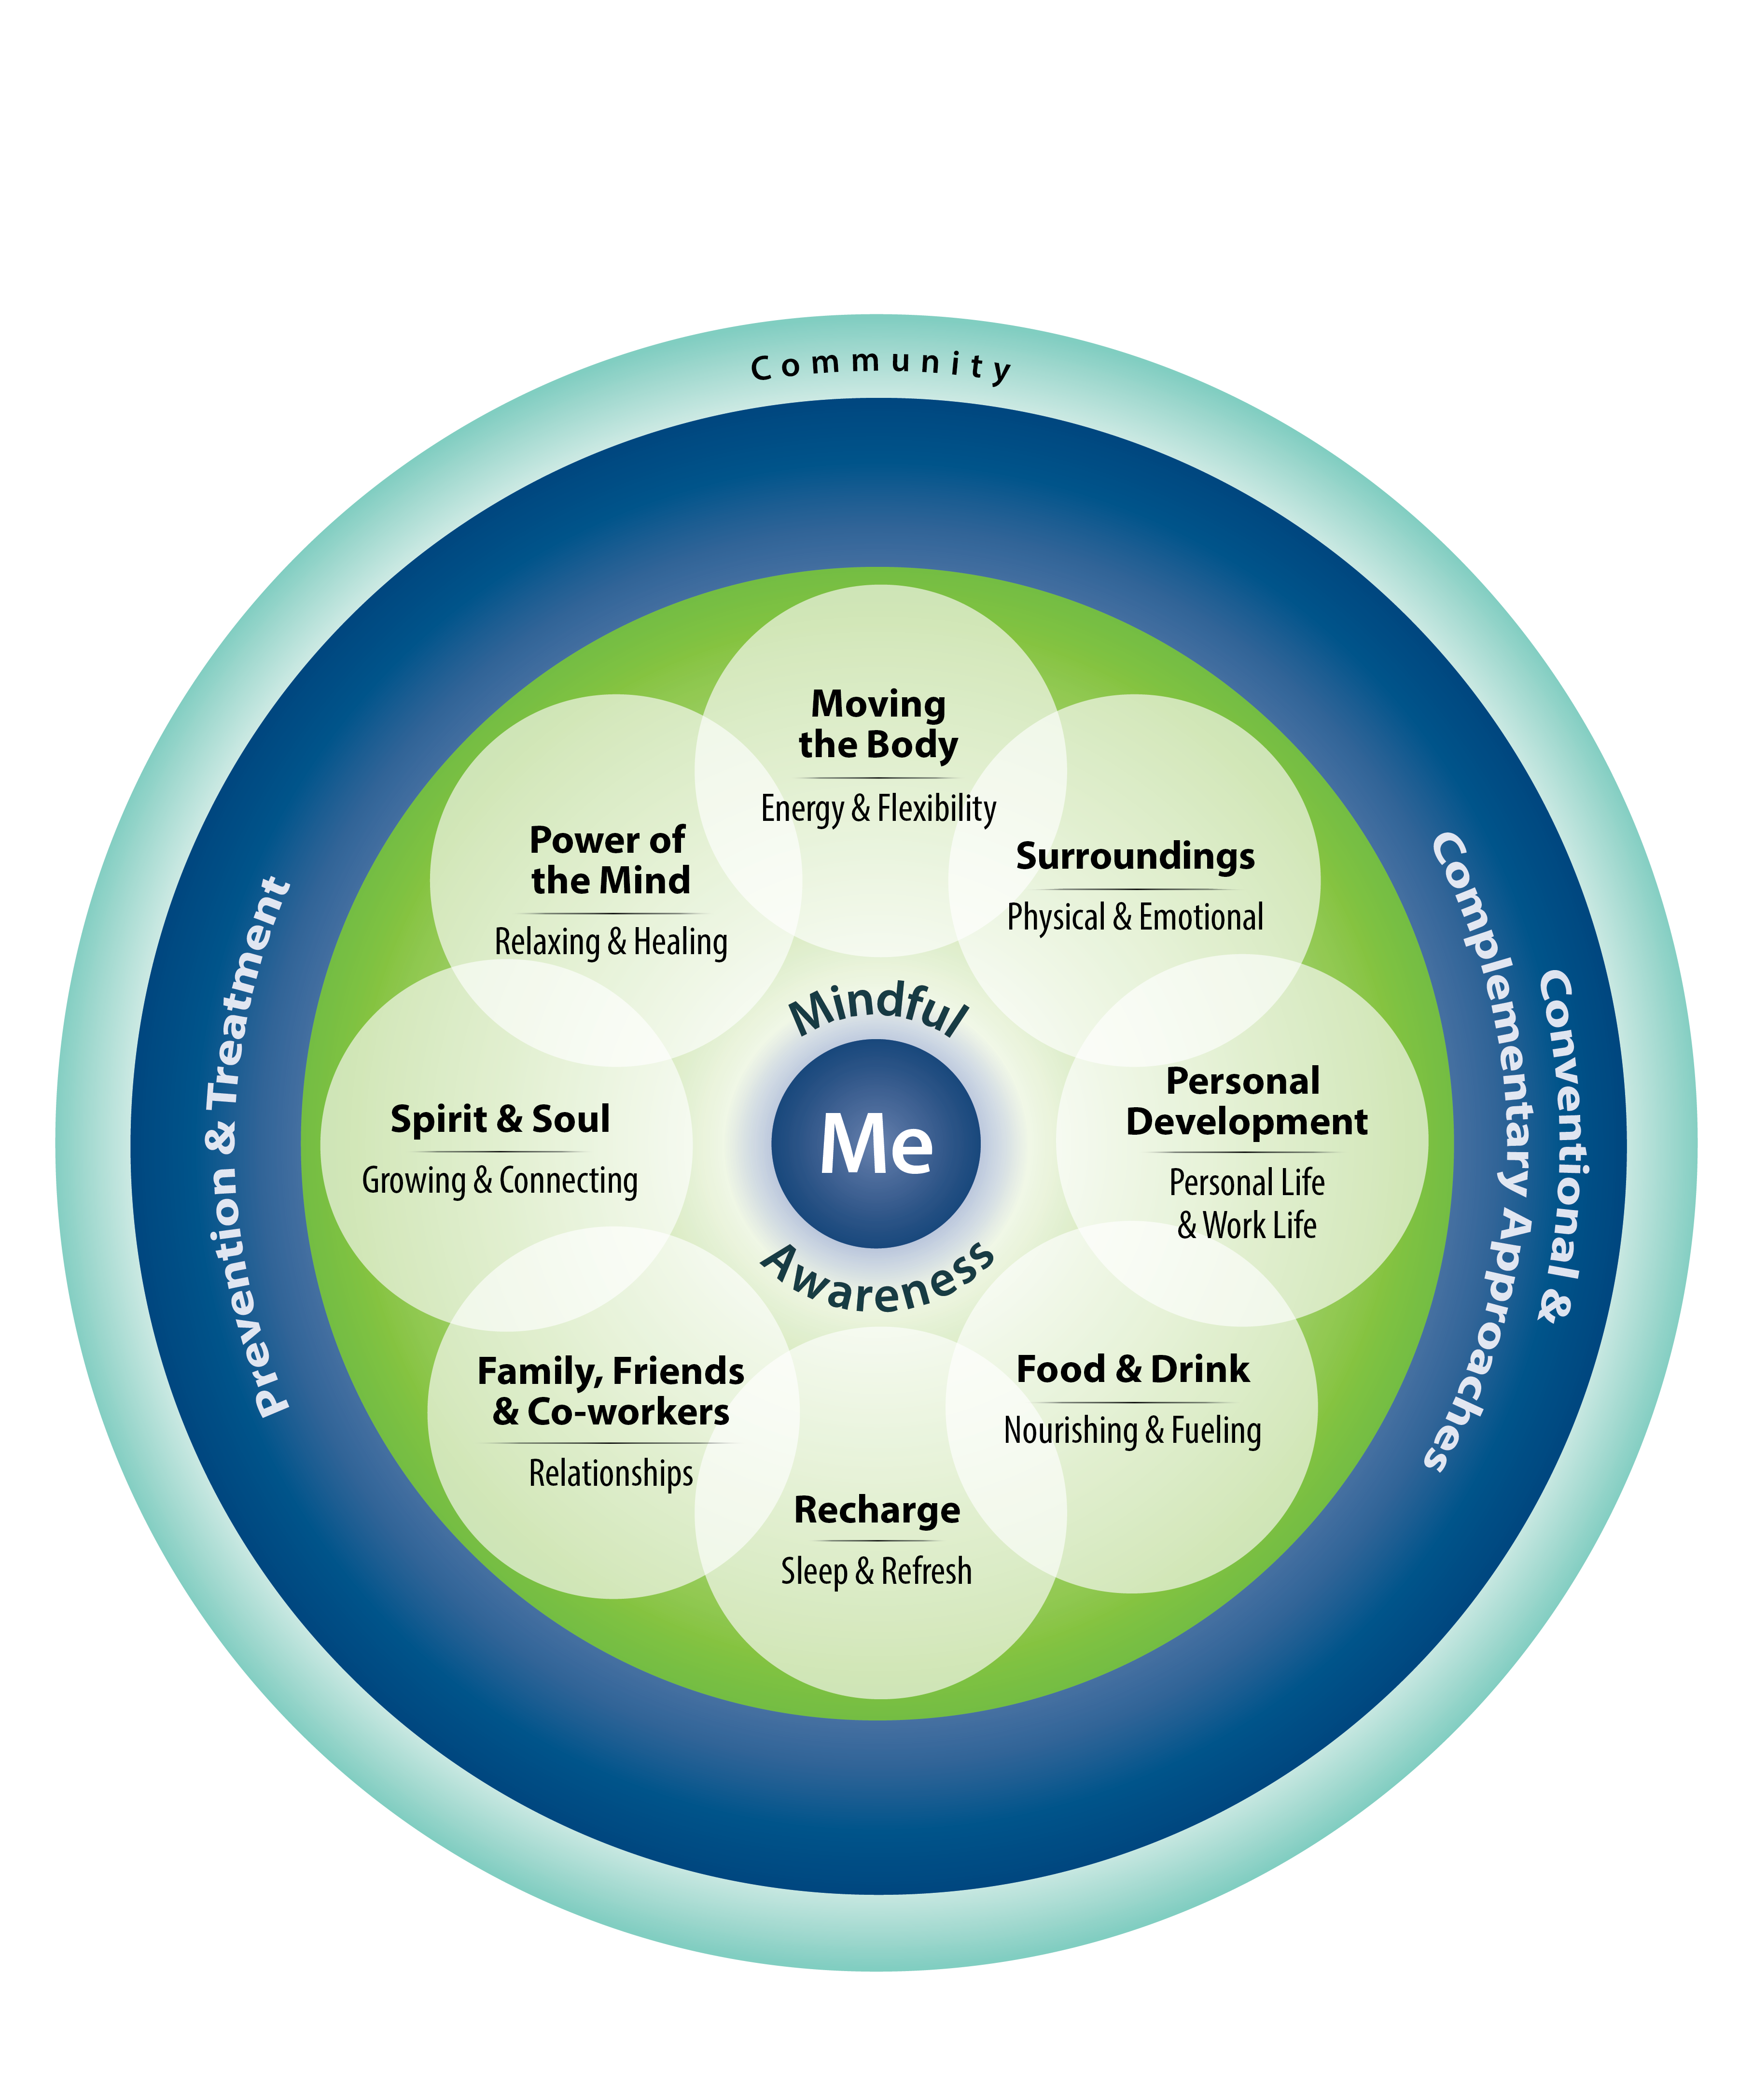
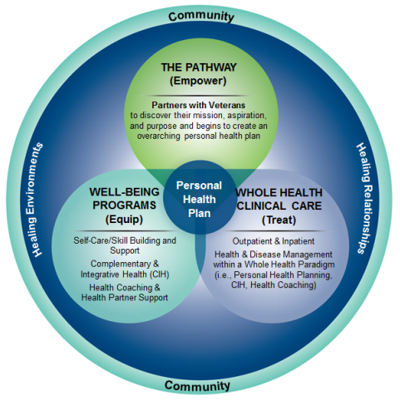
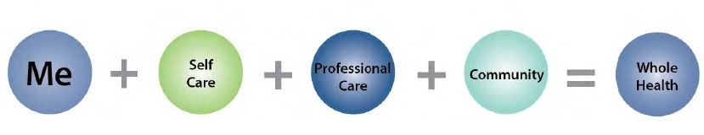
Moving from “What’s the Matter with You?” to “What Matters to You?”
  Whole Health is an approach to health care that empowers and equips people to take charge of their health and well-being and live their life to the fullest.
Circle of Health
Whole Health System
Notes:
The Circle of Health and its Interconnected Synergistic components
VA will significantly improve Veteran health outcomes by shifting from a system primarily focused on disease management to one that is based on partnering with Veterans throughout their lives and focused on Whole Health. VA will provide personalized, proactive, patient driven health care to empower and equip Veterans to take charge of their health, well-being, and to adopt healthy living practices that deter or defer preventable health conditions.
A Whole Health system focuses not only on treatment but also on self-empowerment, self-healing, self-care, and improvements in the social determinants of health.
How will we know we have arrived? Veterans have a good quality of life, defined by presence of positive emotions in daily activities, participation in society, satisfying relationships, and overall life satisfaction.

Slide 9
A Perspective on the Measurement of Whole Person Health
“Growing interest in moving away from a reductionistic view of the person and health services
Focus on improving the health of the whole person—current routinely collected measures often do not capture change that might be engendered by Whole Health
Need for agreement on what this focus entails and how to measure its achievement
Suggestions for moving the measurement discussion forward:
  Separate measurement of whole person health (WPH) from measurement of WPH determinants
  WPH: end goal or ultimate outcome to improve and/or maintain
  WPH determinants: things that can be intervened upon to maximize WPH”
  Measuring What Matters: Medical Care Special Issue December 2024 - Volume 62 - Issue 12 : Medical Care
Herman, P. M., Rodriguez, A., Edelen, M. O., DiGuiseppi, G., Zeng, C., Coulter, I. D., & Hays, R. D. (2024). A Perspective on the Measurement of Whole Person Health. Medical care, 62(12 Suppl 1), S24–S26. https://doi.org/10.1097/MLR.0000000000002047
Notes:
Herman, P. M., Rodriguez, A., Edelen, M. O., DiGuiseppi, G., Zeng, C., Coulter, I. D., & Hays, R. D. (2024). A Perspective on the Measurement of Whole Person Health. Medical care, 62(12 Suppl 1), S24–S26. https://doi.org/10.1097/MLR.0000000000002047

Slide 10
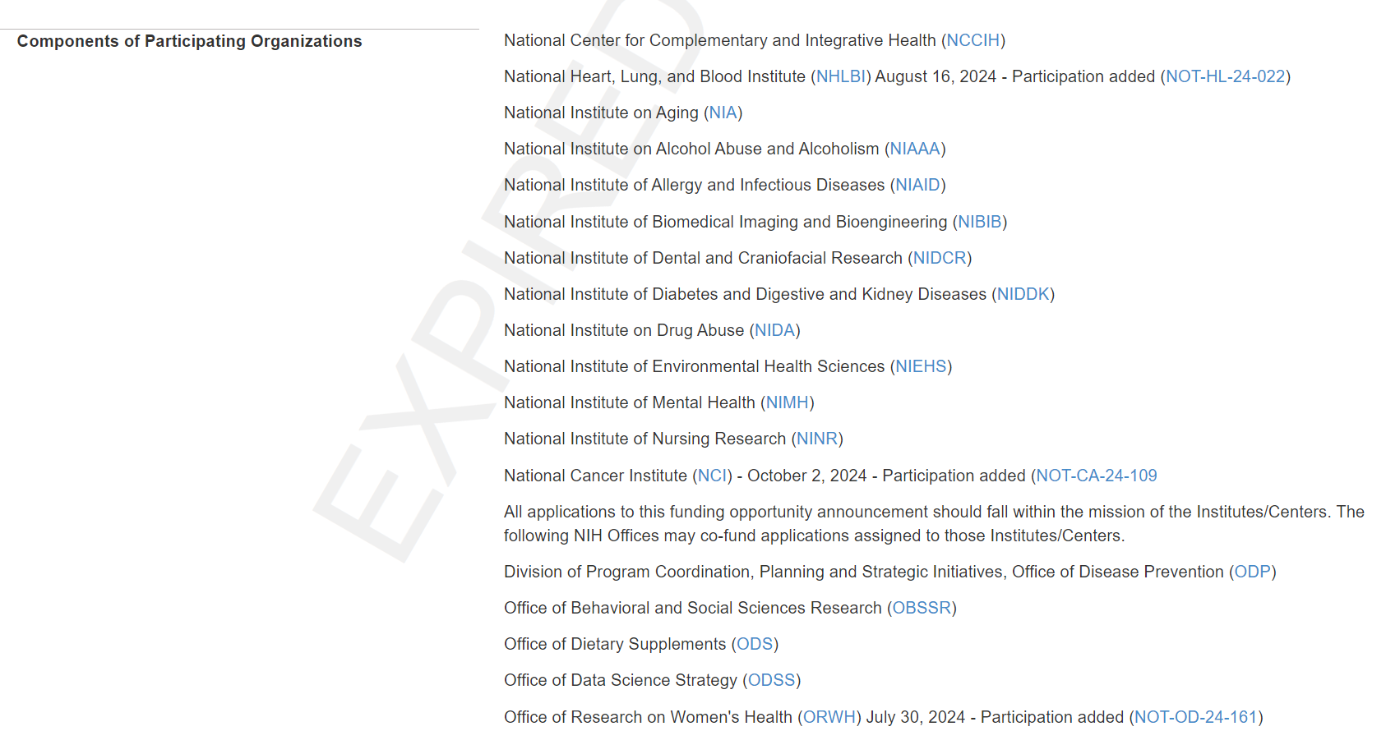
Whole Person Research and Coordination Center

Slide 11
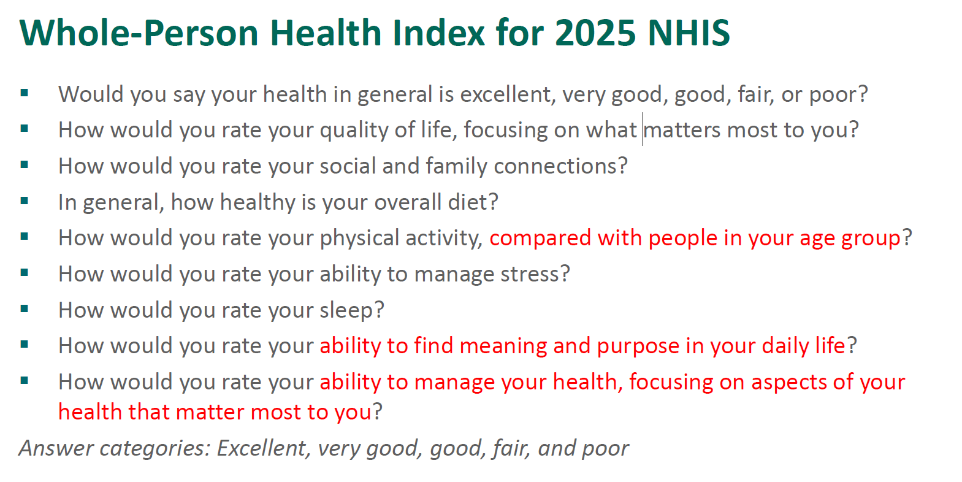
NCCIH Whole Person Index

Slide 12
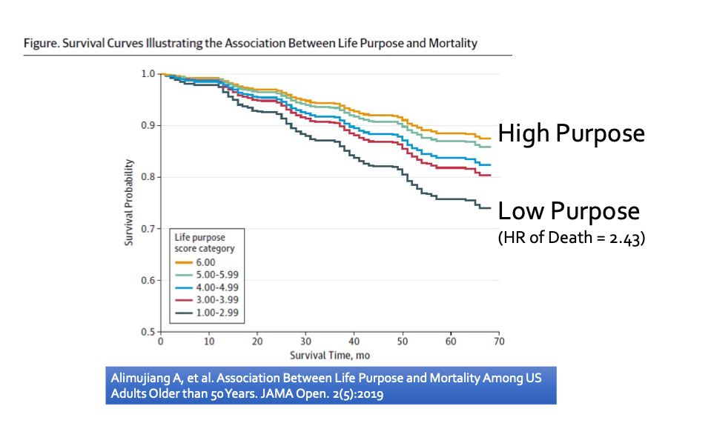
What is the HEART of Whole Health/Well-Being?

Slide 13
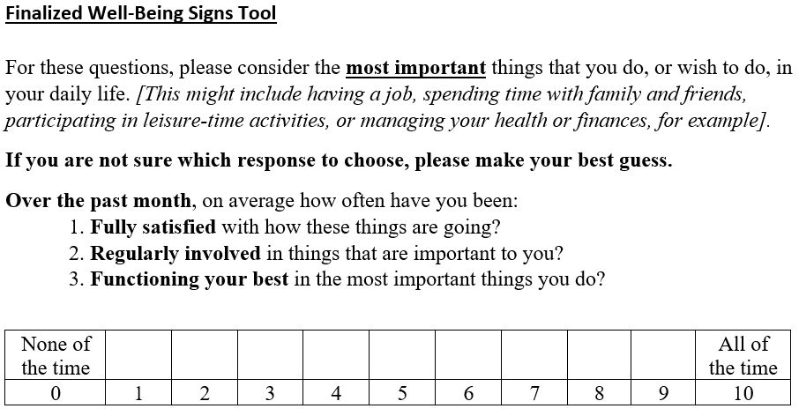
Well-Being Signs
!
Well-Being Signs SharePoint

Slide 14


Slide 15
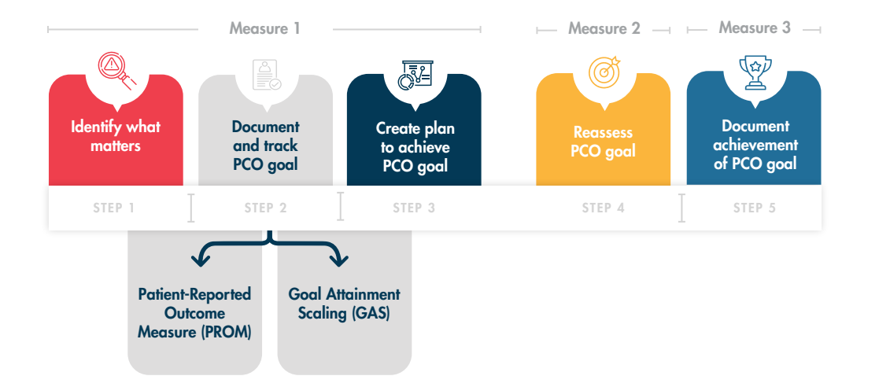
Notes:
PCO= Person-Centered Outcome goal

Slide 16
Overview of Purpose and Process
Notes:
National and International recognition, which informed the work of Whole Health in the States ( Taryn wrap-up at 2:20)

Slide 17

WHITS Focus:
Current Focused:
Building and engaging a broader community
Creating shared learning experiences.
Scaling and spreading lessons from partners and early adopters .
Notes:
The measurement framework is a product of Whole Health in the States (WHITS) which is a program of the Academic Consortium for Integrative Medicine and Health. Originally focused on supporting the efforts of Early Adopters of comprehensive, whole-person pain care, who overcame barriers to providing this care, we are now focused on

Slide 18
WHITS STRATEGIES
1
2
3
4
Broaden Application
Increase access
to non-pharmacologic
treatments for pain
Drive Utilization
of Comprehensive
Pain Care
Create Measurement & Implementation
Framework
Many access barriers exist but insurance coverage
is a giant one
Deploy resources and
strategies needed to
drive utilization
Apply these strategies to other conditions beyond pain care.
Practical strategies for clinics or systems to capture essential evaluation information
Notes:
Early on our WHITS PI Sam Simmons strategic focus was on understanding the barriers to increasing access and utilization of comprehensive pain care, and her work identified and supported partners in overcoming some of those barriers, from that work the importance of measurement was recognized And so today our strategy is focused on creating implementation and measurement framework to support practical strategies for clinics and systems to capture essential evaluation information, and then we want to expand our partner group to aid in applying these strategies to other conditions beyond pain care. To discuss the importance of measuring whole health comprehensive pain care, we’ve been working with partners to develop this measurement framework

Slide 19

Practical Process
Roadmap to defining a Whole Health Measurement Framework:
Evaluate existing frameworks and literature
Identify & Convene key stakeholders and partner
Define Framework : Elements, Measures, Integration into Practice (Living Document)
Develop a Framework
Disseminate, Collect Feedback, Enhance
Resource elements of WHITS demonstration program measurement projects to support evaluation
Includes 6 Key Processes
Notes:
In addition to evaluating existing frameworks and literature, we also recognized the need to harness lessons from some of our WHITS partners on what they were evaluating, we needed to support them in evaluating their whole health models of pain care to determine the outcomes, then with a smaller working group which was also informed by national partners, we defined the framework, and we are currently refining the draft framework, building the virtual home, working on supplemental education, and plan to disseminate and continue to enhance as the vision is for this framework to be a living document

Slide 20
Measurement Framework Purpose
Tools to Support the Scale and Spread of Whole Health (Chronic Pain)
Examples: Measures and Models
Explore different examples of models from different settings.
Demonstrate Impact
Decision Maker Resource
Offer healthcare providers and administrators tools to support the scaling and spread of whole health models for pain care, focusing on chronic pain.
Examples of tracking and measuring the effectiveness of whole health models in comprehensive pain care.
Demonstrate impact for patients, systems, payors, and clinicians.
Serve as a resource for decision-makers and partners (policymakers, educators, researchers, EHR vendors).
Notes:
The intended purpose of the measurement framework is to
Offer healthcare providers and administrators tools to support the scaling and spread of whole health models for pain care, focusing on chronic pain.
Examples of tracking and measuring the effectiveness of whole health models in comprehensive pain care.
Explore different examples of models from different settings.
Demonstrate impact for patients, systems, payors, and clinicians.
Serve as a resource for decision-makers and partners (policymakers, educators, researchers, EHR vendors).

Slide 21
Goals of the Framework
Provide Practical Guidance
Whole Health Measurement, in the context of Comprehensive Pain Care
Consider Range of Measurement and Evaluation Domains
Clinical Focused Tool (primary), but Considers Other Stakeholder Groups
Stakeholder Relationships
Adaptable to Different Setting
Share Preliminary Information from Partners
Notes:
Our primary goals align with supporting the purpose I just outlined and our future users.

Slide 22
Framework & Collaboration
Collaborative Effort: Insights from three WHITS partners and national resources.
Evolving Science: Framework is comprehensive but a starting point, not exhaustive.
Importance of Measures: Critical to recognize how measures inform care and drive transformation in health care.
Support for Different Audiences: Provides foundation from partners’ experiences.
Notes:
It’s been a collaborative efforts with our partners, targeting an understanding of what is being measured, why it is being measured, how those measures are integrative into care, what outcomes are being seen in these whole health models and how measurement might change based on settings and stakeholder. We recognize the evolving science around whole health, and so we are aiming to be comprehensives but also recognize that this framework will be a starting point for many new partners and users.

Slide 23
Samples from the Framework

Slide 24
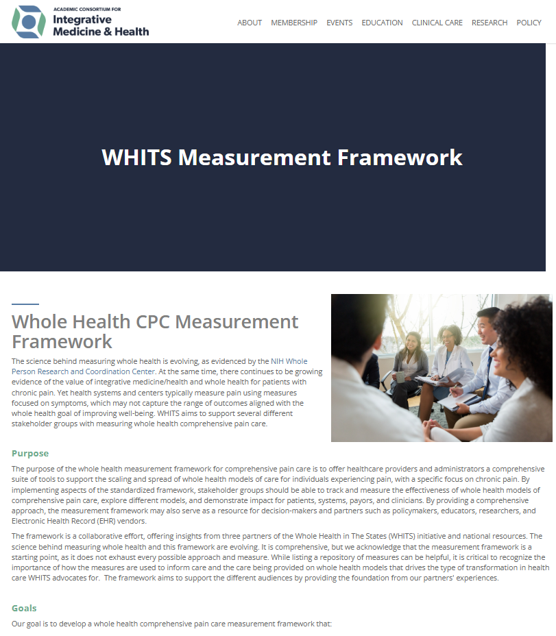

Framework
Skeleton
Purpose & Goals
Definition of WH in the context of CPC
Stakeholder Analysis & Measures
Lessons from VHA, FQHC, Health System
  Measurement Tables
Considerations & Implementations Discussion
Supporting Resources
Offer supplemental learning modules to guide different users through the framework
Notes:
The resource will be web-based and will be accompanied by supplemental learning modules to guide different users types through the framework. The group working on the frame works, selected the option of using tables to display information as an easy to follow format. We wanted to share some draft examples of what you can anticipate seeing in the finished product.

Slide 25
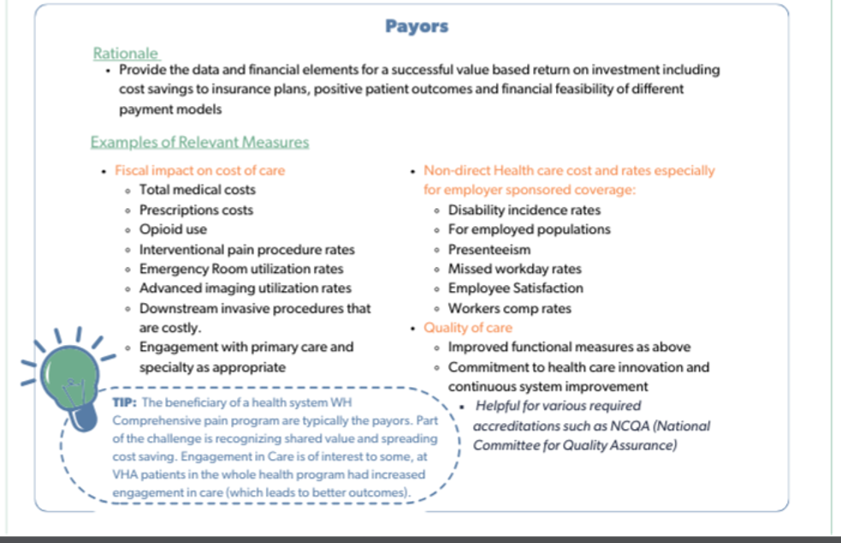
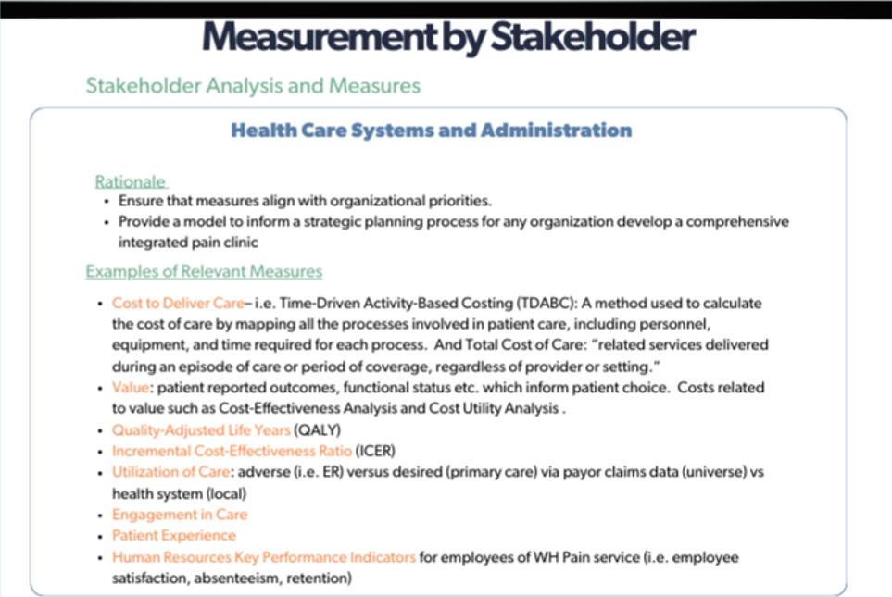
Sample from Stakeholder
Section
DRAFT
DRAFT
Notes:
Sample of part of the Stakeholder Engagement and Analysis Section, where we list rationale and role of potential stakeholders, and discuss the role of different potential measures

Slide 26
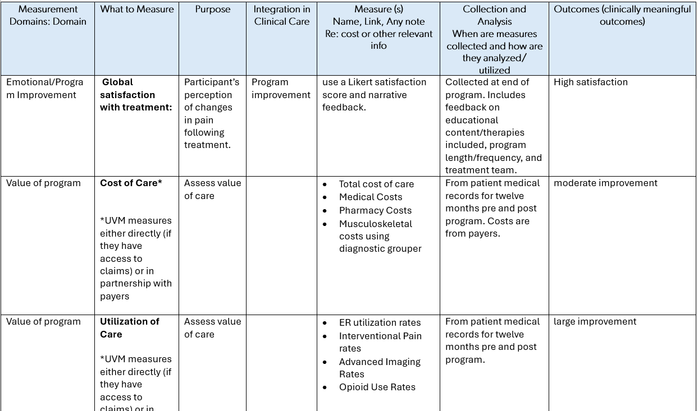
Measurement Table Example:
Asked Partners to Provide the following in their tables:
Consider Direct and Indirect Outcomes
Measurement Domain
Purpose of the measure/Why measure it?
How is the measure integrated into patient care?
What validated measure/tool is being utilized in the setting
Additional Information: Collection, Analysis, Outcomes
Desire to Consider measurement and evaluation as they relate to:
Patient Reported Outcomes:
  Symptoms and Diseases such as Pain
  Quality of Life and function across all life domains
  Patient Experience
  Well-Being
Cost and Utilization of Care
Value
Therapeutic Relationship
Provider Experience (Well-being and Satisfaction)
DRAFT
Notes:
To answer questions, we receive from different programs, as part of our ”Lessons from different health care settings” section, we’ve collaborated with our partners to create measurement tables that look at several different kinds of Data, share tools to evaluate different domains, share Information on Collection and Analysis such as when and how measures are collected, and how are they analyzed and utilized.

Slide 27
Whole Health Comprehensive Pain Care Measurement Project Timeline
TASKS
JAN- JUNE 2024
JULY-DEC
2024
JAN-JUNE 2025
JULY-DEC
2025
Resource Partners Support Measurement
Stakeholder Working Groups & Feedback
Content Development
Refinements
Website Development & Launch
July 2025 Launch
Education and Disseminate
WHITS CoP
Workshops & Asynchronous Learning
Target Web Launch: Summer 2025
Notes:
We have been fortunate to have great partners, and we anticipate launching the framework this coming summer, at the end of the session we will provide the QR code to the web address where you can check for updates, and my email to stay in touch. While listing a repository of measures can be helpful, it is critical to recognize the importance of how the measures are used to inform care. Dr. Bokhour will share how through her work, the importance of identifying the correct measures

Slide 28
MEASURING WHAT MATTERS MOST
Notes:
Barbara wrap-up at 2:35

Slide 29
Value of CIH and Whole Health for Chronic Pain Patients
Growing evidence of the value of CIH and Whole Health for patients with chronic pain:
Health systems typically measure pain using measures focused on symptoms
These measures may not capture the range of outcomes aligned with Whole Health goals
Notes:
Barbara (keep or drop) Logic Model should be developed with your stakeholders, transition to Josh

Slide 30
VHA PMOP PAIN MEASURE SET
Subjective Health Status
Sleep Quality
Self-Rated Health* (SRH; 1 item)
Sleep Quality Scale* (SQS; 1 item)
Pain Intensity
Pain Intensity, Interference with Enjoyment, Interference with General Activity Composite* (PEG; 3 items)
Depression and Anxiety
Patient Health Questionnaire-4 comprised of PHQ-2 and GAD-2 (PHQ-4; 4 items)
Self-Efficacy
Pain Self-Efficacy Questionnaire* (PSEQ-2; 2 items)
General
Well-Being
Well-Being Signs* (WBS; 3 items)
Catastrophizing
Perceived Impact of Treatment
Patient Global Impression of Change* (PGIC; 1 item)
Concerns About Pain (CAP-2; 2 items)
* sensitive to monitor change and care outcome
All measures have been evaluated for validity and reliability, most in patients with pain
For a full list of tools and measure citations within the PMOP Pain Measurement Set, visit Pain Management, Opioid Safety, and PDMP (PMOP): https://www.va.gov/PAINMANAGEMENT/Research/Tools-Assessment-Recruitment.asp
U.S. Department of Veterans Affairs. (2025, January 31). Pain Management, Opioid Safety, and PDMP (PMOP): VA CLINICIAN AND RESEARCHER - Tools for Assessment and Recruitment. Go to VA.gov. https://www.va.gov/PAINMANAGEMENT/Research/Tools-Assessment-Recruitment.asp

Slide 31
How do we know what to measure to capture the Whole Person Outcomes:
Using Logic Models to Guide Measurement
Notes:
Say something here about CARA
Alternative approaches to pain management and conduct research

Slide 32

Why create a logic model?
Road Map for Evaluation and
Program Planning

Slide 33
What is a Logic Model?
1979 Joseph Wholey
  Developed in response to being asked to evaluate the impact of programs where goals and objectives were vague, programs didn’t really exist, or weren’t being implement in a way that would achieve the expected results.
Helps articulate the program theory
Notes:
Graphic representation of the logical if-then relationship between a programs activities and anticipated outcomes
Makes explicit linkages between inputs, activities, outputs, and the change you hope to see (outcomes and impacts)
Some people call this the theory of action too.
Every program starts with a theory about how the program works - Logic modeling helps identify the theory and assumptions behind the theory- Many funders require them because understand their value for visually depicting what a program intends to do and for planning appropriate evaluations of those programs

Slide 34

Simple Logic Models
Headache example
Enhancing Program Performance with Logic Models, University of Wisconsin-Extension, Feb. 2003

Slide 35
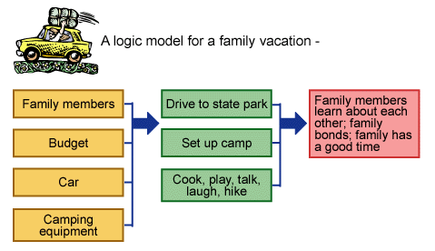
Simple Logic Models
Taking a vacation example:
Enhancing Program Performance with Logic Models, University of Wisconsin-Extension, Feb. 2003

Slide 36
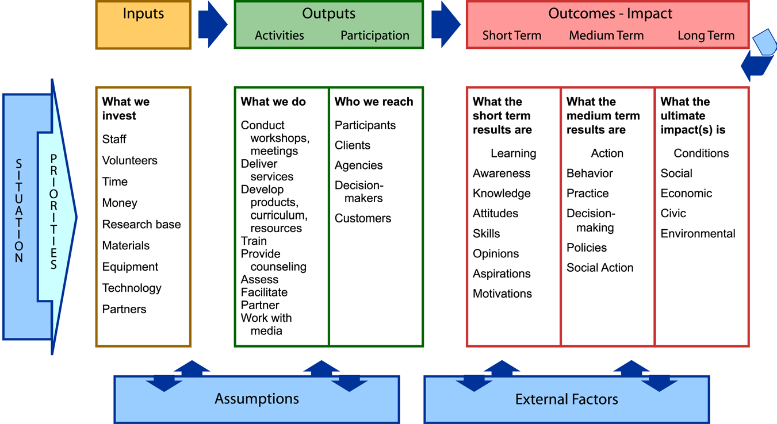
Full Logic Model Framework
Enhancing Program Performance with Logic Models, University of Wisconsin-Extension, Feb. 2003
Notes:
One final outcome/impact we are often interested in that is not on here are changes in health outcomes.

Slide 37
WHY WE DEVELOPED OUR LOGIC MODEL
Evaluation on the impacts of a large-scale program: Implementation of Whole Health Care in VA
Focus on patients with chronic pain in response to a Congressional mandate for evaluation of programs in VA (CARA act)
Disease and symptom based outcomes insufficient to capture the intended outcomes of Whole Health Care.
Notes:
Th

Slide 38

PROCESS OF CREATING LOGIC MODEL:
Work with team to define a program and its goals (create the logic model)
Important interactive process to help define:
and creates a common understanding….
* Where are you going?
* How will you get there?
* What will show that you’ve arrived?
Notes:
IN step 1 we worked with our partners at our program office who were implementing the program
We discussed each element
Met iteratively with VA operational program leaders to ask
What the components of Whole Health Care are
What are the inputs for implementation (resources)
What are the outputs for implementation (activities)
Expected short, medium and long term outcomes

Slide 39
What Did We Measure and Why?
Experience of care
CollaboRATE
Consultation and Relational Empathy (CARE)
Satisfaction with Care
Discussion of and help with patient goals
Logic
Model
Engagement in care
Altarum Consumer Engagement (ACE)
Healthcare commitment (Health Behaviors)
Healthcare navigation (Health decisions)
Well-being
Perceived Stress Scale (PSS)
PROMIS-10 (functional outcomes)
Sense of life meaning and purpose
Life Engagement Test
Pain interference
Pain, Enjoyment, General Activity (PEG)
Notes:
As I spoke about earlier, the WHS is intended not to focus on individual disease-based outcomes, rather on Veteran’s goals, engaging them in their care so that they can improve their overall health and well-being.
We worked collaboratively with OPCC&CT to develop a logic model of how components of the WHS would impact Veterans. WE discussed program components and measuring short term, mid term and longer term outcomes.
The first layer of impact is Veterans’ experiences of their care – WH would lead to greater satisfaction with care and experiences of patient-centeredness within care.;
“In the past 6 months, have you discussed your personal health goals with a VA provider?”
In the past 6 months, how helpful were your VA healthcare providers in helping you make progress towards your primary personal health goal?”
This in turn would lead to greater Veteran engagement in health care decisions and self-management behaviors
In turn, Veterans would experience greater overall sense of well-being and a sense of life meaning and purpose.
Finally, for this pain cohort, WH would lead to lesser pain interference.

Slide 40

Conclusions
Experience of care
Engagement in care
Well-being
Sense of life meaning and purpose
Pain interference
Notes:
Compared to Conventional Care users, WH users had significantly greater improvements over 6-months in satisfaction with care, perceptions of care as patient-centered, and engagement with care
Prior literature shows that better satisfaction with care, perceptions of interactions and engagement in care are associated with better health outcomes
Thus, outcomes at 12-months may show differences in more “downstream” outcomes

Slide 41
Measurement & Different Stakeholder Groups
Notes:
Josh wrap-up at 2:50

Slide 42

Stakeholder Analysis and Measures
Stakeholder analysis is an important step and will expand your understanding of potential impacts that both internal and external stakeholders may have on your project.
We will share some real-life examples from WHITS partners (University of Vermont)
We also aim to discuss how measurements may be differently valued or weighted based on stakeholder group, highlighting the integral role each stakeholder plays in the success of the framework.
Notes:
We aim to provide a suite of stakeholders and potential measures Organizations can select their suite of measures based on capacity and by identifying internal and external stakeholders and what’s essential to the different groups. In this section, we emphasize the importance of stakeholder engagement, sharing the stakeholder groups that WHITS partners identified and tips on how to effectively engage each group. We also discuss how measurement requirements may change based on stakeholder group, highlighting the integral role each stakeholder plays in the success of the framework.

Slide 43
Stakeholder Analysis Process
Stakeholder Analysis Process
List Potential Internal and External Stakeholders to Consider
Stakeholder Chart including rationale and list of relevant measures by stakeholder group.
Considerations for how to engage with the stakeholder groups, and data sourcing
Notes:
List Potential Internal and External Stakeholders to Consider
Stakeholder Chart including rationale and list of relevant measures by stakeholder group.
Considerations for how to engage with the stakeholder groups, and data sourcing

Slide 44
Internal Health System Stakeholders
Patients
Family & Caregivers
Health System Contracting/Health Reform/Value based contracting
Referring providers
  Primary Care Physicians
  Sub-specialties
Administrators (e.g. CFO)
Employees of the clinical delivery service
  Front Desk Admin-Staff (stakeholders who might administer the measures)
  Clinical team
Researchers & Educators
Notes:
Want to add researchers?

Slide 45

External Health System Stakeholders
Government Payors and Decision Makers:
  Medicaid
  Medicare
  Congress/State Government and Legislator-VHA
Uninsured/underinsured
Commercial Payors - National/Local/Regional
  Government managed programs
    Managed Medicaid
    Medicare Advantage
  Health Exchange – individual, small employers
  “Traditional” Insurance – medium employers
  Large employers (self-insured/own risk)
    Quasi state - teachers unions, state employees
    Large Employers

Slide 46
Value is in the eye of the…..
Health Care Systems and Administration
  Finance – what is the cost of delivering the service and are we covering costs?
  Clinical Leadership – Is this aligned with our strategic plan and how does this help us with our own external stakeholders?
  Contracting/Health Care Reform – Is this generating value and how can this be used in the shift to value- based contracting? Analysis?
  HR – Does this contribute to employee retention, improve employee engagement?
Payors
  Financial analysts – “the cost is the cost”
  Clinical/Admin leaders – Value=Q/C – How does this enable us to sell to and retain clients?
  Health Care Reform – How does this move us to value based care to satisfy regulators?

Slide 47
Value is in the eye of the…..
Patients and Caregivers
  Is this program worth my time?
  Does it improve my quality of life as I define it – what really matters to me?
  Individualized measures with differing patient identified value - Fatigue?, Sleep disturbance?, Anxiety and depression?, Ability to participate in social function? Ability to have meaningful engagement with work or volunteer activities? Ability to enjoy life activities?, Overall satisfaction?
Practitioners
  Is this actually making a difference for my patients?
  What and who do we need to do this well?
  Is all this measurement helpful in my day-to-day patient care?
  How can these measures be used to improve the program over time?
  Is my day more fulfilling and can this fuel my passion/reconnect me to the reasons I became a practitioner?

Slide 48
Stakeholders Analysis and Measures
Inform Stakeholders
This framework aims to emphasize the importance of stakeholder engagement, sharing the stakeholder groups that WHITS partners identified and tips on how to effectively engage each group.
Consideration by Stakeholder Group
We also aim to discuss how measurement requirements may change based on stakeholder group, highlighting the integral role each stakeholder plays in the success of the framework.
Stakeholder Engagement
Whole Health Comprehensive Pain Care Measurement provides essential information to different stakeholders.
Notes:
(hand off to Ben on next slide for Q &A) We aim to provide a suite of stakeholders and potential measures Organizations can select their suite of measures based on capacity and by identifying internal and external stakeholders and what’s essential to the different groups. In this section of the framework, we emphasize the importance of stakeholder engagement, sharing the stakeholder groups that WHITS partners identified and tips on how to effectively engage each group. We also discuss how measurement requirements may change based on stakeholder group, highlighting the integral role each stakeholder plays in the success of the framework.

Slide 49
Comments, Questions,
Discussion on Usability, Feasibility, Partners, and Opportunity Areas
Notes:
BEN LEADS: here are prompts for the group to consider, since I included them in the submission
1. How does the work of the group translate to other settings? 2. What measures should be preserved regardless of setting, and which look different in different settings? 3. How do you see evaluating whole health comprehensive pain care evolving over the next 5 years?

Slide 50

STAY CONNECTED
Measurement Framework
Website:
Share feedback email Taryn.DeSioGarber@IMConsortium.org
Launching Measurement Framework Site
Summer 2025
THANK YOU!!!!!

Slide 51
Selected References and Resources
Bikker A, Fitzpatrick B, Murphy D, Mercer SW. Measuring empathic, person-centred communication in primary care nurses: validity and reliability of the consultation and relational empathy (CARE) measure. BMC Fam Pract. 2015;2015(16):149. doi:10.1186/s12875-0150374-y 26.
Bokhour, Barbara G. PhD*,†; Vogt, Dawne PhD‡,§; Kligler, Benjamin MD, MPH∥,¶. Measuring What Matters Most: Considering the Well-Being of the Whole Person in Health Care. Medical Care 62(12):p S1-S3, December 2024. | DOI: 10.1097/MLR.0000000000002088
Bokhour, B. G., Hyde, J., Kligler, B., Gelman, H., Gaj, L., Barker, A. M., Douglas, J., DeFaccio, R., Taylor, S. L., & Zeliadt, S. B. (2022). From patient outcomes to system change: Evaluating the impact of VHA's implementation of the Whole Health System of Care. Health services research, 57 Suppl 1(Suppl 1), 53–65. https://doi.org/10.1111/1475-6773.13938
Cohen S, Kamarck T, Mermelstein R. A global measure of perceived stress. J Health Soc Behav. 1983;24(4):385-396.
Duke CC, Lynch WD, Smith B, Winstanley J. Validity of a new patient engagement measure: the Altarum consumer engagement (ACE) measure. Research support, non-U.S. Gov't. The Patient. 2015;8(6): 559-568. doi:10.1007/s40271-015-0131-2 29.
Elwyn G, Barr PJ, Grande SW, Thompson R, Walsh T, Ozanne EM. Developing CollaboRATE: a fast and frugal patient-reported measure of shared decision making in clinical encounters. Research. Patient Educ Couns. 2013;93(1):102-107. doi:10.1016/j.pec. 2013.05.009 28
  collaboRATE Measure: https://www.glynelwyn.com/collaborate-measure.html
Etingen, B., Cohen-Bearak, A., Adjognon, O. L., Vogt, D., Hogan, T. P., Gaj, L., Orner, M. B., Barker, A. M., & Bokhour, B. G. (2024). Measuring patient well-being during whole-person clinical care. Medical Care, 62(12). https://doi.org/10.1097/mlr.0000000000002054
Gallup-Healthways Well-Being Index. Methodology Report for Indexes. Gallup Inc.; 2009.
Hays RD, Bjorner JB, Revicki DA, Spritzer KL, Cella D. Development of physical and mental health summary scores from the patient reported outcomes measurement information system (PROMIS) global items. Qual Life Res. 2009;18(7):873-880. doi:10.1007/ s11136-009-9496-9
Herman, P. M., Rodriguez, A., Edelen, M. O., DiGuiseppi, G., Zeng, C., Coulter, I. D., & Hays, R. D. (2024). A Perspective on the Measurement of Whole Person Health. Medical care, 62(12 Suppl 1), S24–S26. https://doi.org/10.1097/MLR.0000000000002047
Kellogg Foundation. (2001). Logic model development guide: Logic models to bring together planning, evaluation & action. Battle Creek, MI: W.K. Kellogg Foundation.
Krebs EE, Lorenz KA, Bair MJ, et al. Development and initial validation of the PEG, a three-item scale assessing pain intensity and interference. J Gen Intern Med. 2009;24(6):733-738. doi:10.1007/s11606009-0981-1
Mercer SW, Maxwell M, Heaney D, Watt GCM. The consultation and relational empathy (CARE) measure: development and preliminary validation and reliability of an empathy-based consultation process measure. Research. Fam Pract. 2004;21(6):699-705. doi:10.1093/ fampra/cmh621 27.
National Academies of Sciences. Engineering, and Medicine Achieving Whole Health: A New Approach for Veterans and the National. The National Academies Press; 2023.
National Center for Complementary and Integrative Health. NCCIH Strategic Plan FY 2021–2025: mapping a pathway to research on whole person health. 2021. Accessed August 9, 2024. https://nccih.nih.gov/about/nccih-strategic-plan-2021-2025
Plavin, J., Landau, J., Rose, G. L., Ziller, E., Nowak, S., Finley, H., Audy, L., & Porter, J. (2024). Overview and Feasibility of a Novel Transdisciplinary Integrative Approach to High Impact Chronic Pain in Vermont. Global advances in integrative medicine and health, 13, 27536130241271643. https://doi.org/10.1177/27536130241271643
Scheier MF, Wrosch C, Baum A, et al. The life engagement test: assessing purpose in life. J Behav Med. 2006;29:291-298. doi: 10.1007/s10865-005-9044-1
University of Wisconsin-Madison (n.d.) Enhancing Program Performance with Logic Models. https://logicmodel.extension.wisc.edu/
U.S. Department of Veterans Affairs. (2025, January 31). Pain Management, Opioid Safety, and PDMP (PMOP): VA CLINICIAN AND RESEARCHER - Tools for Assessment and Recruitment. Go to VA.gov. https://www.va.gov/PAINMANAGEMENT/Research/Tools-Assessment-Recruitment.asp

Slide 52
We recognize that this is an Evolving Process
Notes:
The science behind measuring whole health and this framework are evolving. It is comprehensive, but we acknowledge that the measurement framework is a starting point, as it does not exhaust every possible approach and measure. While listing a repository of measures can be helpful, it is critical to recognize the importance of how the measures are used to inform care and the care being provided on whole health models that drives the type of transformation in health care WHITS advocates for. The framework aims to support the different audiences by providing the foundation from our partners' experiences.

Slide 53
The Whole Health approach to care prioritizes understanding and aligning with what truly matters to the patient and then integrates these personal goals into individualized care plans.
Notes:
As part of the measurement framework, we are developing tables to digest what and how these measures can be collected.

Slide 54
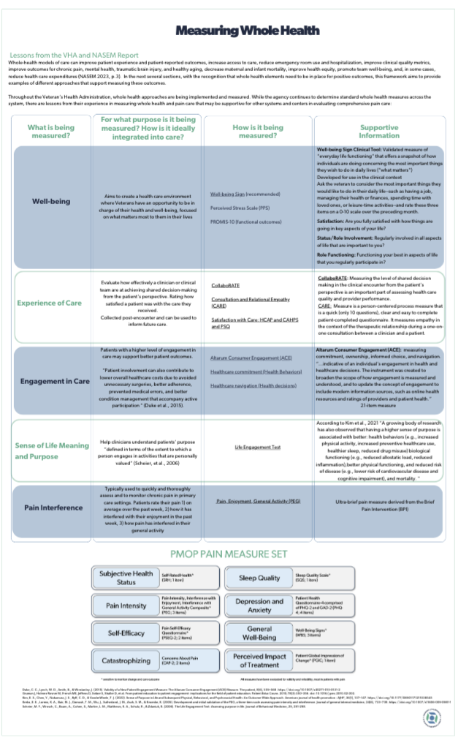
Sample
Lessons from VHA

